Slide 1
Unit II Pharmacoeconomics

Slide 2
Introduction
Health economics is the science of assessing cost and benefits of healthcare.
Pharmacoeconomics is a branch of health economics which compares the value of one drug or a drug therapy to another

Slide 3
Pharmacoeconomics can be considered as a branch of health economics which identifies, measures, and compares the costs and consequences of pharmaceutical products and services.
It describes the economic relationship which combines the drug research, its production and distribution, storage, pricing, and further use by the people.
Pharmacoeconomics can be classified as the field of study that evaluates the behavior or welfare of individuals, firms, and markets for the relevance of pharmaceutical products, services, and programs.

Slide 4
Pharmacoeconomics is a field within health economics that focuses on the economic aspects of pharmaceutical drugs and therapies, comparing their costs and effects.
It aims to identify, measure, and compare the costs and consequences of drug therapy for healthcare systems and society, helping to determine the best use of healthcare resources.

Slide 5
Features
Cost Assessment: Identifying and quantifying direct and indirect costs associated with drug therapies, including medication costs, healthcare utilization, lost productivity, and other related expenses.
Outcome Evaluation: Measuring the effectiveness of treatments in terms of clinical outcomes, economic impacts (e.g., cost savings), and humanistic outcomes (e.g., quality of life).
Methodologies: Employing various analytical techniques such as cost-minimization analysis, cost-benefit analysis, cost-effectiveness analysis, and cost-utility analysis to compare interventions.

Slide 6
Decision-Making Support: Providing data and insights to inform decisions about drug formularies, prescribing practices, and resource allocation to ensure the most efficient and effective use of healthcare resources.
Perspective: Considering different perspectives in the evaluation, such as the patient's perspective, the healthcare provider's perspective, the payer's perspective, and society's perspective.

Slide 7
Key Aspects of Pharmacoeconomics
Comparing drug therapies:
Pharmacoeconomics helps to determine the relative value of one drug or therapy compared to another, considering both their costs and benefits.
Decision-making:
It provides data to inform decisions about drug affordability, access, and reimbursement, supporting choices for healthcare providers and policymakers.
Cost-effectiveness analysis:
Pharmacoeconomics studies often involve evaluating the cost-effectiveness of different treatment options, comparing the costs with the benefits in terms of health outcomes.

Slide 8
Cost minimization:
It can also be used to identify the least costly option among equally effective treatments.
Cost-benefit analysis:
This approach evaluates the total economic benefits of a drug against its total costs, often including the value of the benefits to society.
Cost-utility analysis:
This approach considers the quality of life associated with different treatments, often using measures like quality-adjusted life years (QALYs) to assess the overall value of a therapy.

Slide 9
Applications
Drug development:
It can be used to justify the costs of new drug development and to evaluate the overall value of new drugs.
Pricing and reimbursement:
Pharmacoeconomics data is used to set drug prices and determine which drugs are covered by insurance.

Slide 10
Resource allocation:
It helps healthcare organizations make informed decisions about how to allocate resources to optimize patient care.
Policy decisions:
Pharmacoeconomics can inform policy decisions related to drug access, reimbursement, and formulary development.

Slide 11
Importance
Pharmacoeconomics analysis helps to achieve maximum benefit in limited cost.
Clinicians want their patients to receive best care and outcome available.
The payers want to manage rising costs.

Slide 12
Pharmacoeconomics combines the objectives of both clinician and payers by estimating the value of patient outcomes for the expenditure spent on medications and other healthcare services.
In today’s healthcare settings, pharmacoeconomics methods can be applied for effective formulary management, individual patient treatment, medication policy determination, and resource allocation

Slide 13
Limitations
Health economics and pharmacoeconomics is a young science and is slowly developing and testing its methodologies.
Many problems limit the use of health economics in practice.
The whole process may be open to bias, in the choice of comparator drug, the assumptions made, or in the selective reporting of results.

Slide 14
Most studies are conducted or funded by pharmaceutical companies who obviously are interested in the results, and there is a publication bias towards those studies favorable to sponsoring companies.
Health economics is therefore sometimes misused as a marketing ploy.
Clinical pharmacologists should welcome pharmacoeconomics evaluation as a means to promote efficiency and effectiveness of prescribing.

Slide 15
Pharmacoeconomics Analysis
Pharmacoeconomics analysis involves
Choosing a perspective
Identifying and measuring costs
Identifying and measuring consequences

Slide 16
Perspectives of Evaluation
Common perspectives include:
Patient perspective – Portion of cost not covered by Insurance.
Provider perspective – e.g. Hospitals- Direct costs
Payer perspective – e.g. Insurance companies, employers, or the government.
Society perspective - All direct and indirect costs.

Slide 17
Costs
The value of the resources consumed by a program or drug therapy, is defined as Cost.
Healthcare costs are categorized as.
Direct Medical Costs - Drugs, medical supplies, and equipment, laboratory and diagnostic tests, hospitalizations, and physician visits.
Direct Nonmedical Costs -Transportation to and from healthcare facilities, extra trips to the emergency department, child or family care expenses, special diets, and various other out-of-pocket expenses.

Slide 18
Indirect Nonmedical Costs - Morbidity cost – Loss of productivity.
Mortality – Loss of years of service due to premature death.
Intangible Costs - Nonfinancial outcomes of disease and medical care such as pain, suffering, inconvenience, and grief.
Opportunity Costs – Value (economic benefit) of the alternative therapy that was forgone.
Incremental Costs - The extra costs required to purchase an additional unit of effect.
Direct Costs = Direct Medical Costs + Direct non-medical costs
Indirect Costs = Morbidity costs + Mortality costs
Total costs = Direct costs + Indirect costs + Intangible costs

Slide 19
Consequences (Outcomes)
Consequence is defined as the effects, outputs, or outcomes of the program or drug therapy.
Consequences are categorized as…
Economic outcomes –Comparing direct, indirect, and intangible costs with the consequences of medical treatment alternatives.
Clinical outcomes - Medical events that occur as a result of disease or treatment (e.g., safety and efficacy end points).

Slide 20
Humanistic outcomes -Consequences of disease or treatment on patient functional status such as physical function, social function, general health and well-being, and life satisfaction.
Positive outcomes – Desired effect of a drug
Negative outcomes –ADR or toxicity of a drug
Intermediate outcome - Can serve as a proxy for more relevant final outcomes
Final outcome –To get final outcome of reduced MI (Myocardial Infraction) rate, lipid (fatty) lowering agents are being used to decrease LDL ( low-density lipoprotein) levels which is an intermediate outcome.

Slide 21
Pharmacoeconomics Methodologies
Economic evaluations
Partial economic evaluations
Cost consequence analysis (CCA) or Cost outcome analysis (COA)
Cost-of-illness (COI) evaluation
Full economic evaluations
Cost Minimization Analysis (CMA)
Cost Benefit Analysis (CBA)
Cost Effectiveness Analysis (CEA)
Cost Utility Analysis (CUA)
Humanistic evaluation
Health Regulated Quality of Life (HRQOL)
Patient preferences
Patient satisfaction

Slide 22
Cost-Consequence Analysis (CCA)
Partial economic evaluations can
Include simple descriptive tabulations of outcomes or resources consumed
Require a minimum of time and effort
A cost-outcome or cost-consequence analysis (CCA)
Describes the costs and consequences of an alternative
Does not provide a comparison with other treatment options

Slide 23
Cost of Illness (COI) evaluation
COI identifies and estimates the overall cost of a particular disease for a defined population.
COI evaluation method is also known as burden of illness.
It involves measuring the direct and indirect costs attributable to a specific disease such as diabetes, mental disorders, or cancer.
COI evaluation is not used to compare competing treatment alternatives but to provide an estimation of the financial burden of a disease.

Slide 24
Cost Minimization Analysis (CMA)
Cost-minimization analysis is the most basic technique.
CMA involves the determination of the least costly alternative.
For example, if drugs A and B are antiulcer agents equivalent in efficacy and adverse drug reactions (ADRs), then the costs of using these drugs could be compared using CMA.
Another example would be prescribing a generic preparation instead of the brand leader.

Slide 25
Cost Benefit Analysis (CBA)
Measures costs and benefits in monetary terms.
Estimates the strengths and weaknesses of alternatives.
Both the costs and the benefits are measured and converted into equivalent dollars in the year in which they will occur.
The costs and benefits are expressed as a ratio (a benefit-to-cost (B:C) ratio).
Many CBAs measure and quantify direct costs and direct benefits only due to difficulties in measuring indirect and intangible benefits.
This approach is not widely used in health economics.

Slide 26
Cost Effectiveness Analysis (CEA)
The most commonly employed method is cost-effectiveness analysis.
Measures effectiveness (health benefit) in natural units (e.g. years of life saved, ulcers healed) and the costs in money.
It compares therapies with qualitatively similar outcomes in a particular therapeutic area.
For instance, in severe reflux oesophagitis, using a proton pump inhibitor compared to using H2 blockers.

Slide 27
CEA does not allow comparisons to be made between two totally different areas of medicine with different outcomes.
The results of CEA are expressed as a ratio either as an average cost-effectiveness ratio (ACER) or as an incremental cost effectiveness ratio (ICER).
An ACER represents the total cost of a program or treatment alternative divided by its clinical outcome to yield a ratio representing the dollar cost per specific clinical outcome gained, independent of comparators.

Slide 28
Average cost effectiveness (ACER) = Net Cost / Net Health Benefit
The key measure of CEA is the incremental cost effectiveness ratio (ICER).
Incremental Cost Effectiveness Ratio = (Cost of drug A - Cost of drug B) / (Benefits of drug A - Benefits of drug B)
ICER = Difference in costs (A-B) / Difference in benefits (A-B)
CEA is being used to set public policies regarding the use of pharmaceutical products (national formularies) in countries such as Australia, New Zealand, and Canada.

Slide 29
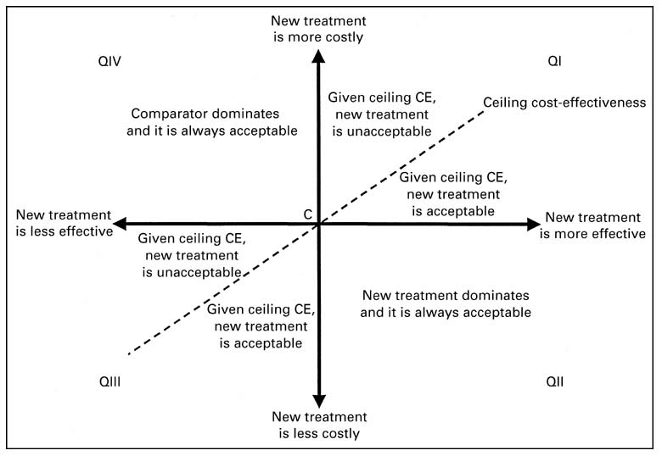

Slide 30
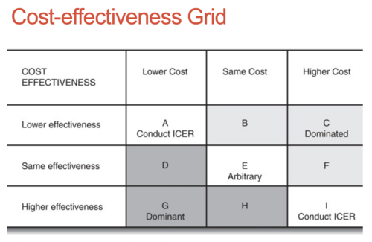

Slide 31
Cost Utility Analysis (CUA)
Cost-utility analysis (CUA) is a method for comparing treatment alternatives that integrates patient preferences and Health Regulated Quality of Life (HRQOL) .
HRQOL measure is an utility, having value between 1.0 (perfect health) and 0.0 (death).
Quality-adjusted life years (QALYs) are then derived by multiplying the time in a health state by the appropriate utility score

Slide 32
In CUA, Cost is measured in dollars, and therapeutic outcome is measured in patient weighted utilities rather than in physical units.
This method is well suited to the evaluation of chronic diseases that have deleterious effects on HRQOL.
Differences between treatments are expressed as the incremental cost per QALY gained.
CUA can compare cost, quality, and the quantity of patient-years.

Slide 33
Results of CUA are expressed in a ratio, a cost-utility ratio (C:U ratio).
CUA is complex, and thus CUA can be limited in scope of application from a hospital or MCO perspective.
CUA is employed less frequently than other economic evaluation methods because of a lack of agreement on measuring utilities, difficulty comparing QALYs across patients and populations, and difficulty quantifying patient preferences.
In CEA, the costs are measured in money and there is a defined outcome. But in CUA, the outcome is an unit of utility (e.g. a QALY).

Slide 34
Humanistic Evaluation Methods
Methods for evaluating the impact of disease and treatment of disease on a patient’s HRQOL, patient preferences, and patient satisfaction are all growing in popularity and application to pharmacotherapy decisions.
HRQOL has been defined as the assessment of the functional effects of illness and its consequent therapy as perceived by the patient.
These effects often are displayed as physical, emotional, and social effects on the patient.
Measurement of HRQOL usually is achieved through the use of patient-completed questionnaires.

